Slide 1
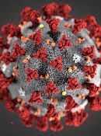
COVID-19 TRIALS PROJECT REPORT
The objective is to explore the dataset to gain insights into the characteristics of COVID-19 clinical trials, such as their status, phases, study designs, and demographics.

Slide 2
ABOUT PROJECT
ClinicalTrials.gov is a database of privately and publicly funded clinical studies conducted around the world.
It is maintained by the National Institute of Health.
All data is publicly available and the site provides a direct download feature which makes it super easy to use relevant data for analysis.
This dataset consists of clinical trials related to COVID 19 studies presented on the site.

Slide 3
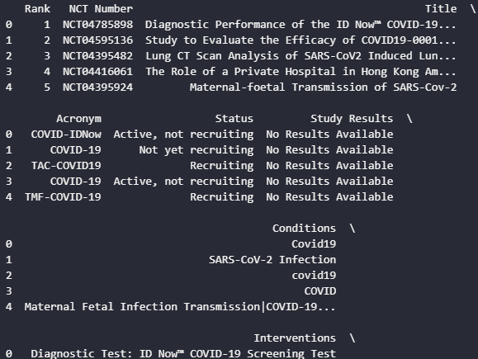
THE HEADS

Slide 4
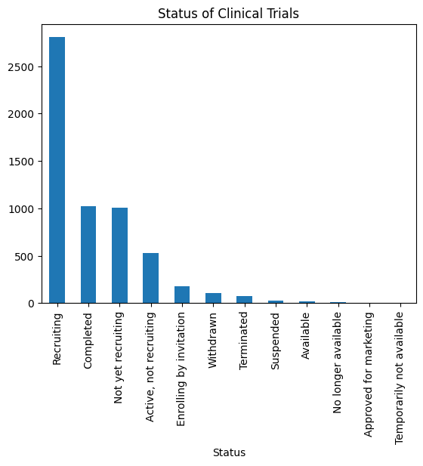
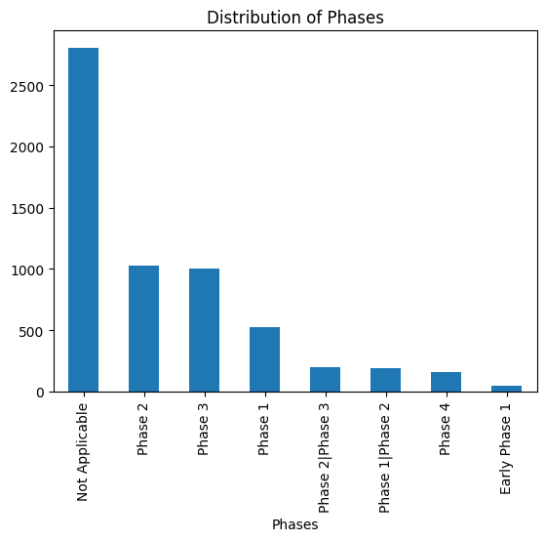
Univariate Analysis
Status Distribution: Analyze the status of clinical trials Phase Distribution: Understand the distribution of trial phases.

Slide 5
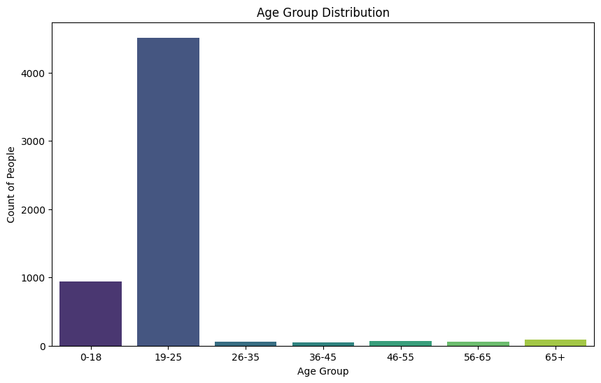
Age Group Distribution

Slide 6
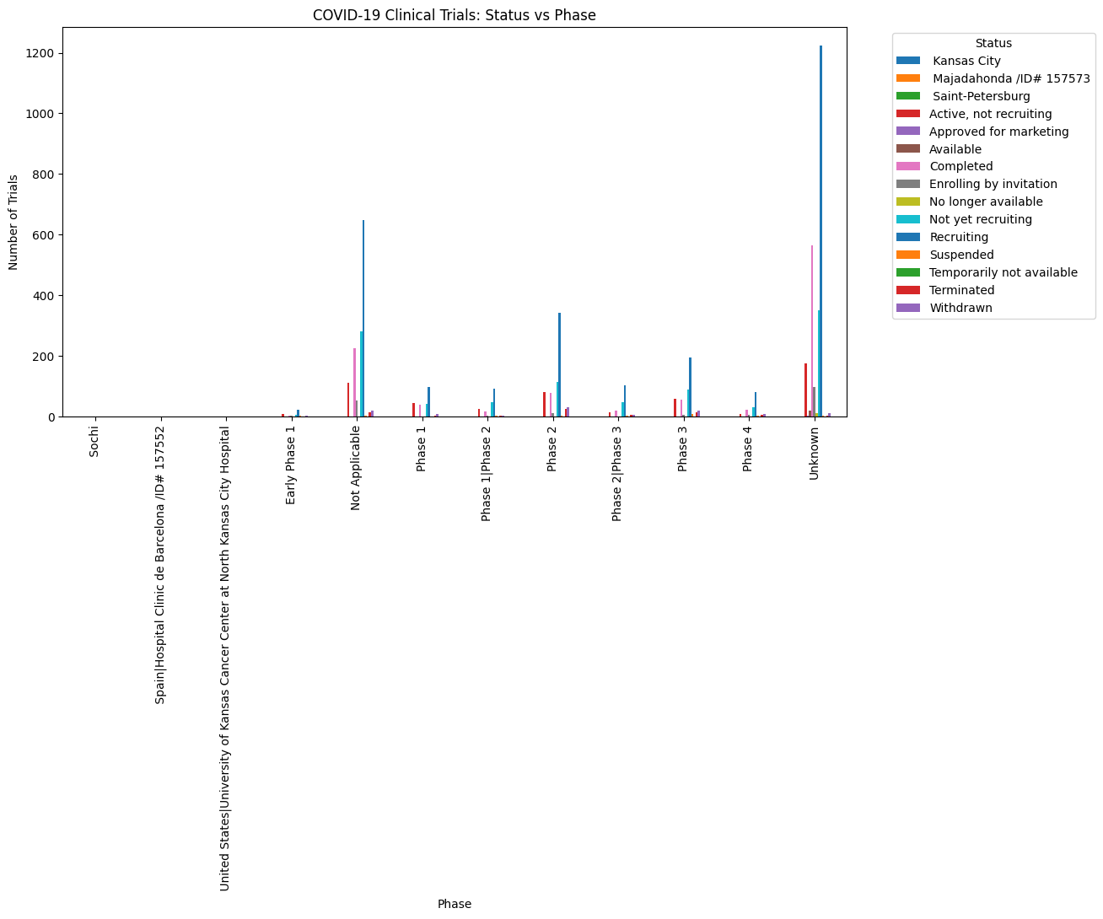
Phases Vs Status Analysis

Slide 7
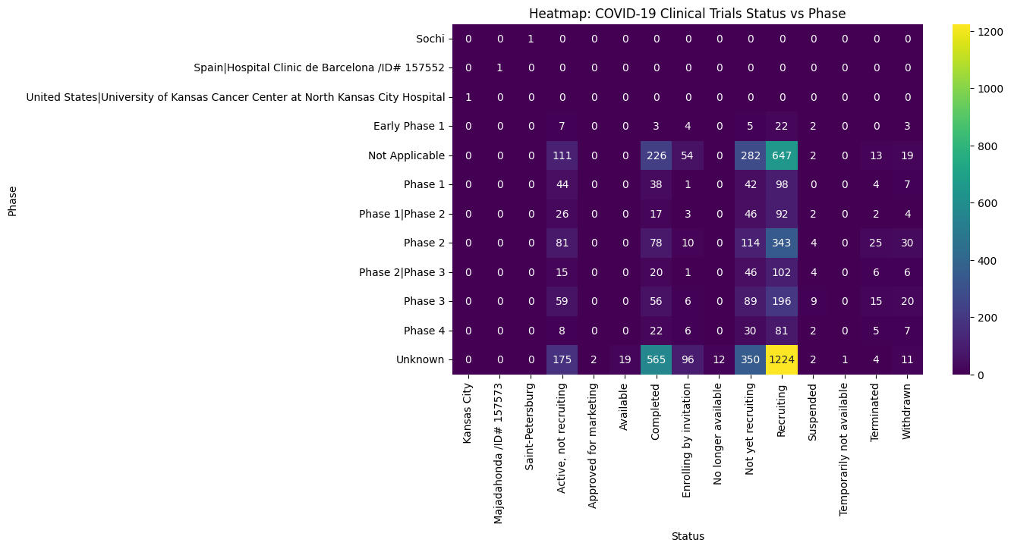

Slide 8
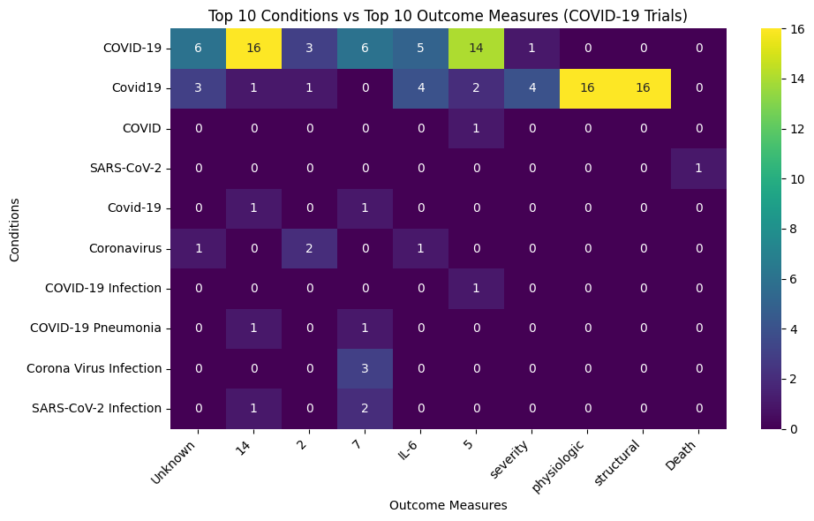

Slide 9
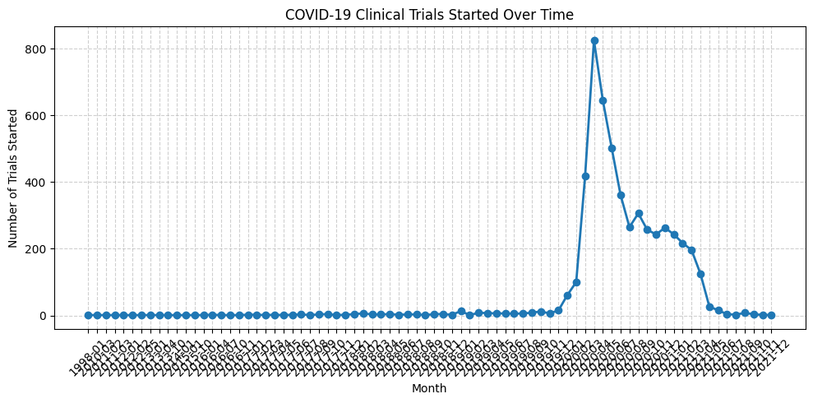

Slide 10
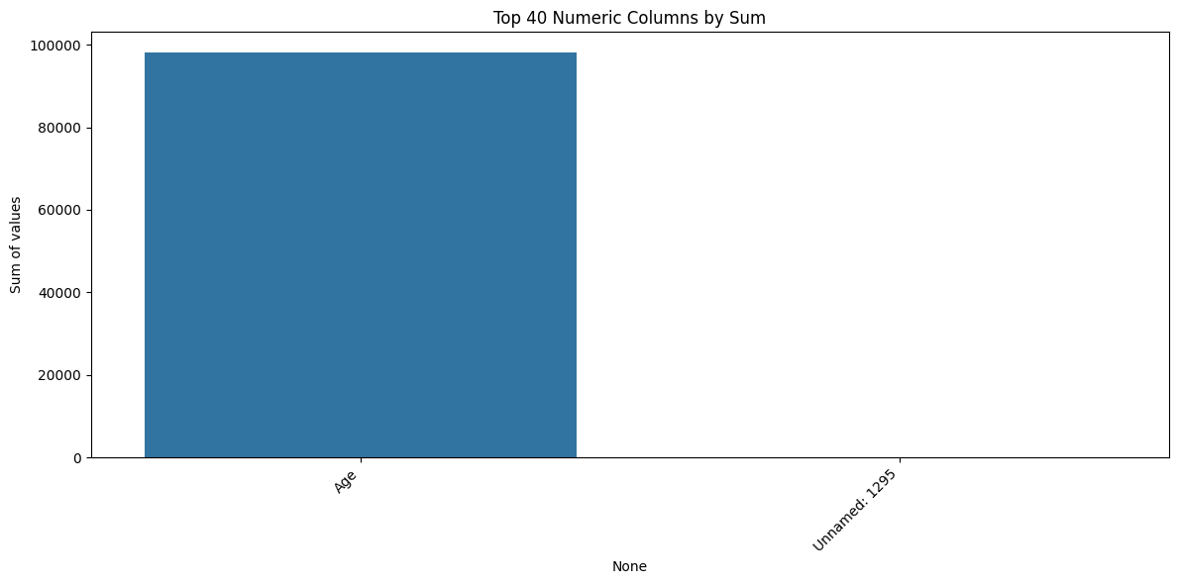
s

Slide 11
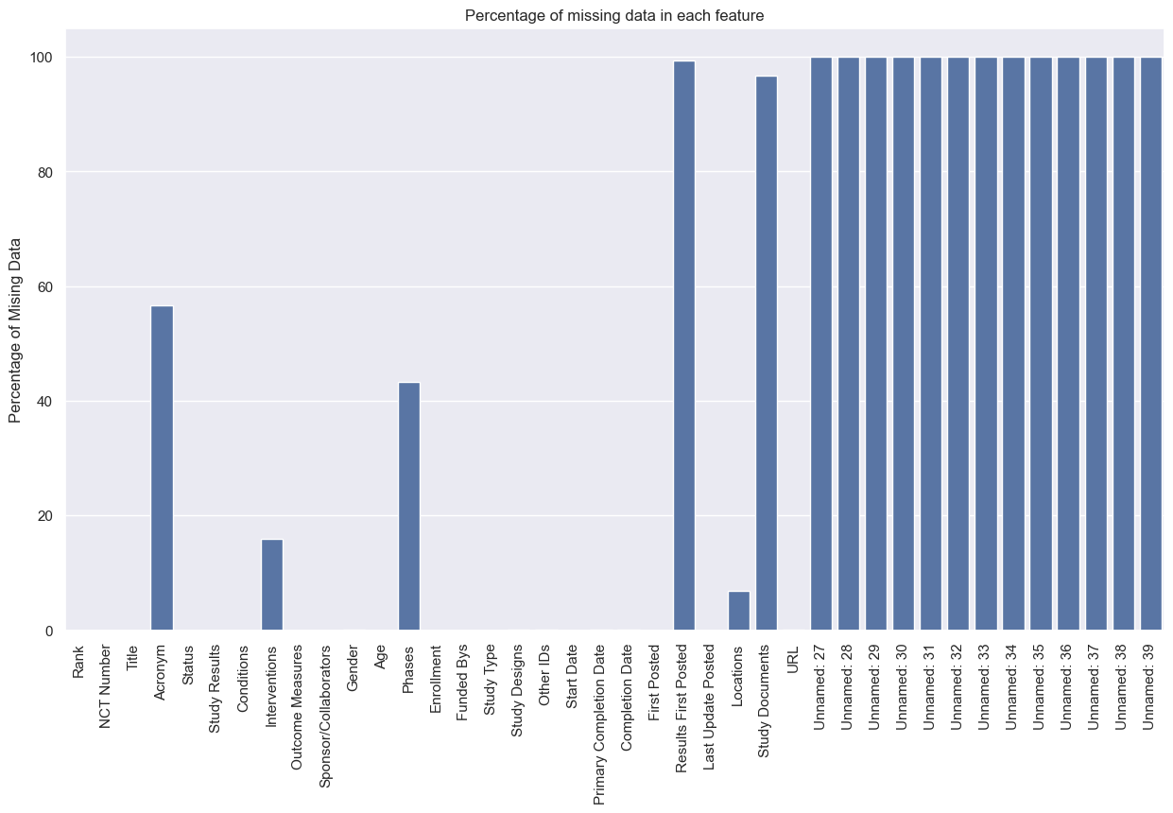
As shown the percentage of missing data in Results First Posted is 99.3% and Study Documents is 96.8%, so it's impossible to impute them without destoying our dataset.

Slide 12
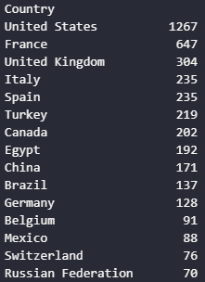
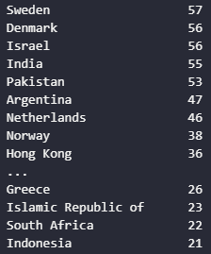
Countries Vs Cases Trials

Slide 13
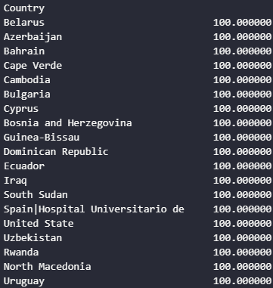
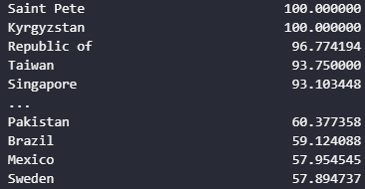
Relation between null values in Acronym and Countries

Slide 14
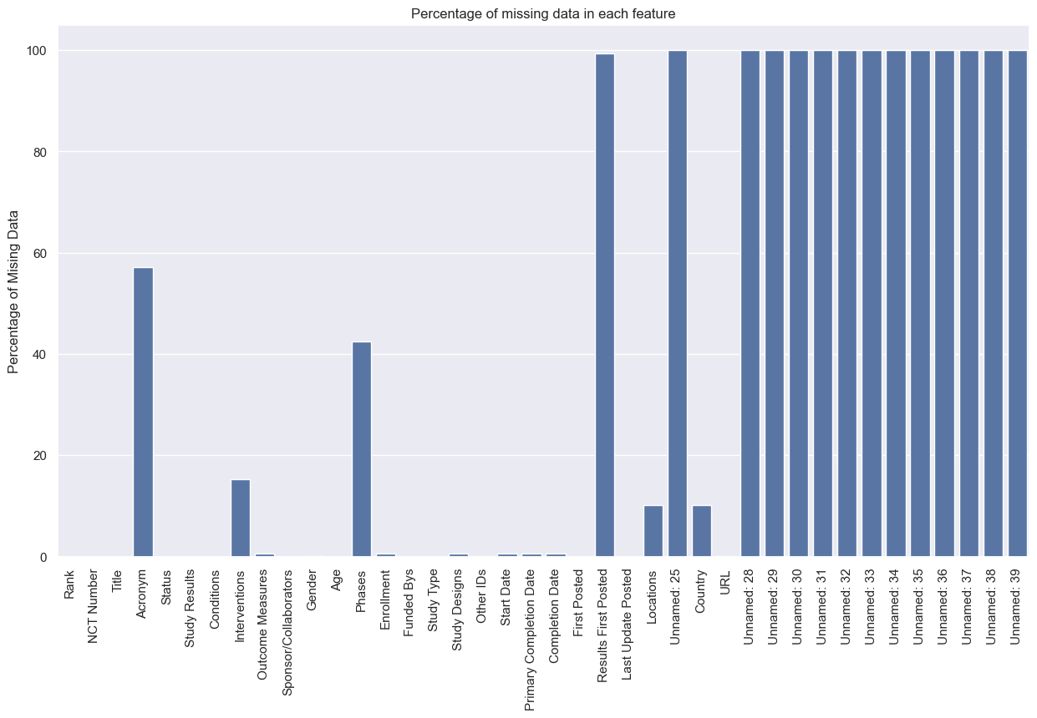

Slide 15
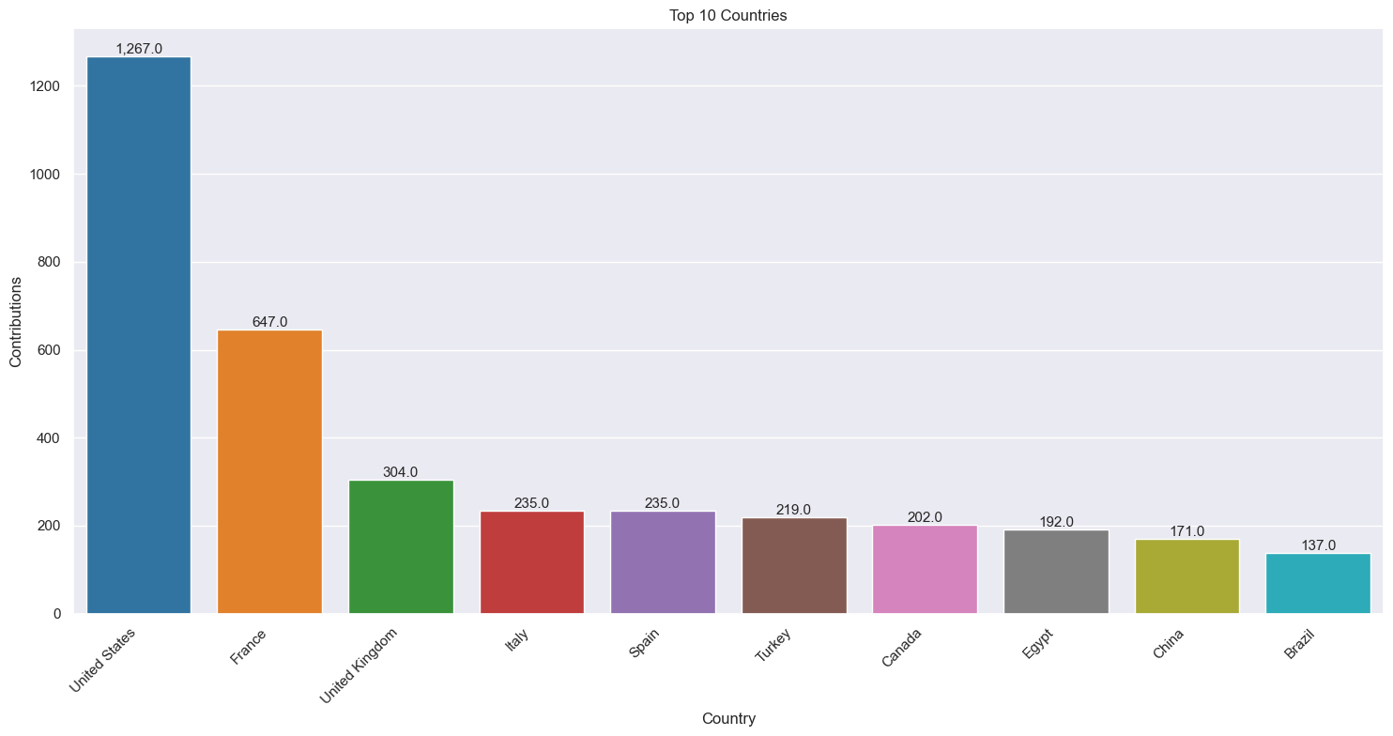

Slide 16
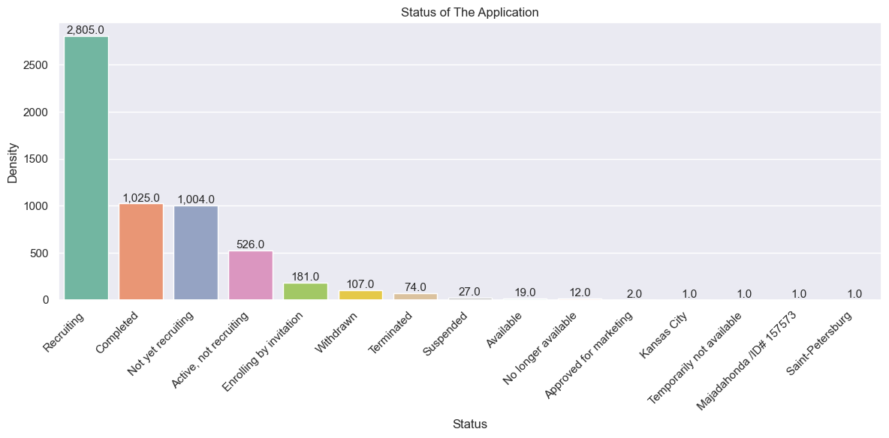

Slide 17
